Slide 1
Poppin’ Portland

Slide 2
Agenda
MVP Summary
Scope Adjustments
Current State
Product Development Timeline

Slide 3
MVP Summary
Target Audience
Foodies
Beer Aficionados
Wanderers
Oenophiles
I’m Bored…
I want to try something new, but don’t know where to look!
I’m new to town!

Slide 4
In Scope
Emphasize Locations by Geolocated Social Media Traffic
Breweries
Wineries
Filter location type on button click event
Dispensaries
Restaurants
Hikes
Pull Yelp Rating
Custom Pin Icons by Location Type
Aggregate social media traffic associated with each location for user reference (Insta, Twitter, etc.)
Search Functionality
Route to Location
Embedded Google Maps

Slide 5
Scope Change Example
During API research, the team determined that social media aggregation in the allotted timeline was not feasible.
Twitter and Instagram APIs required application approval prior to use. Applications were submitted, but approval lead time was unknown.
Instead of aggregating all social media, we were able to find a way to embed a Twitter timeline that dynamically pulls the location’s twitter feed based on the pin selected by the user.
Assumes location has a social media presence on Twitter.

Slide 6
Current State
Brewery and Winery Locations active
Embedded Google Maps
InfoWindow on Marker click event
Yelp Rating API call
Firebase DB for collection Locations
Custom Icons by Location Type
Filter Location Type Visibility on button click

Slide 7


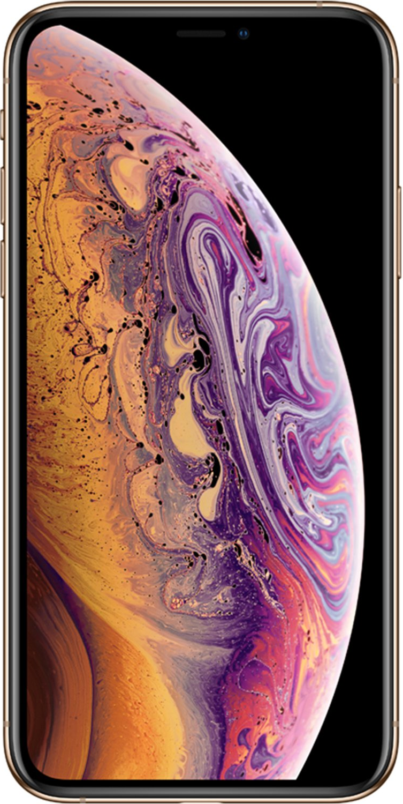


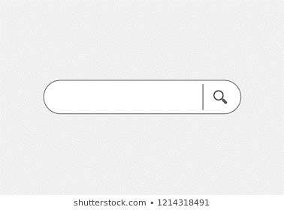
Product Development Road Map
More Location Types
UX Development
Mobile Responsiveness
Search Functionality
Near Future
Q3
2019
Q4
2019

Slide 8
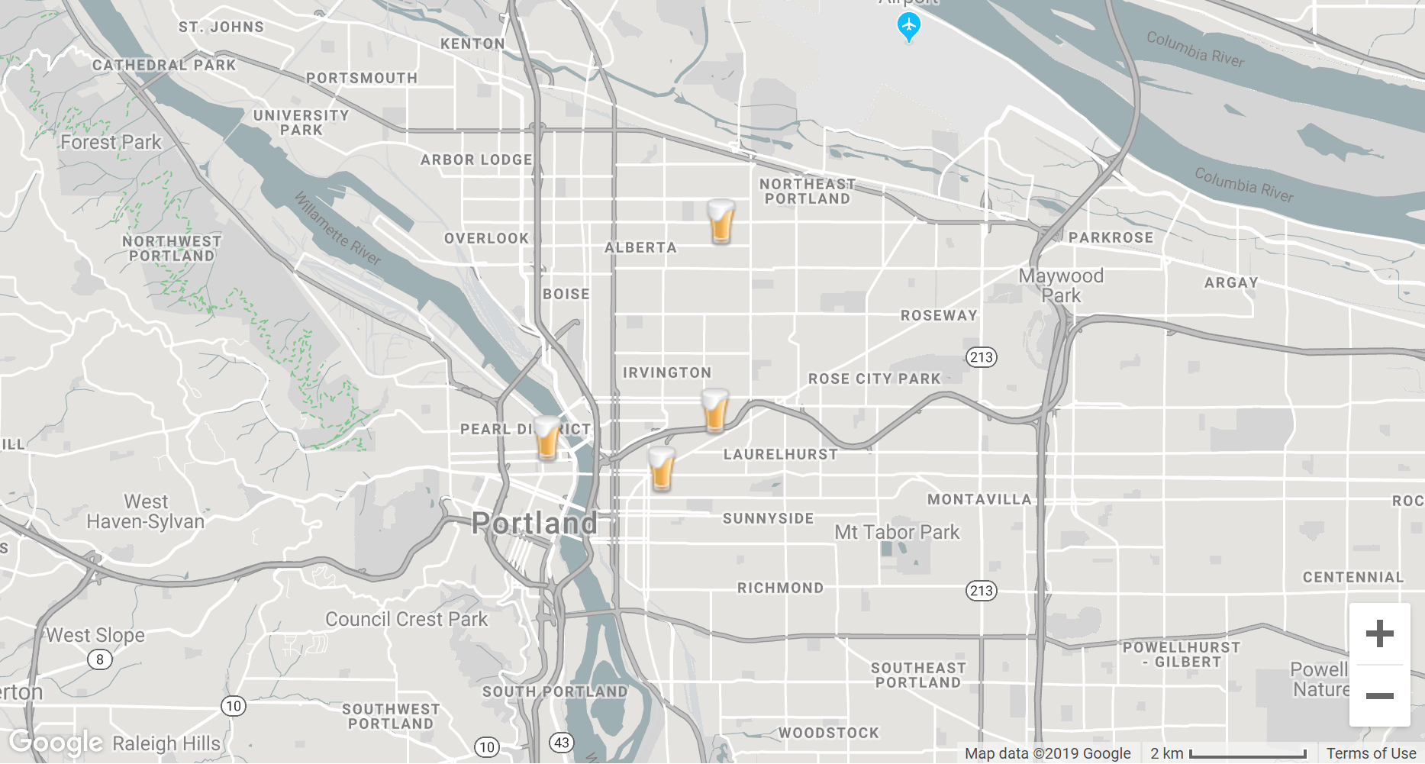
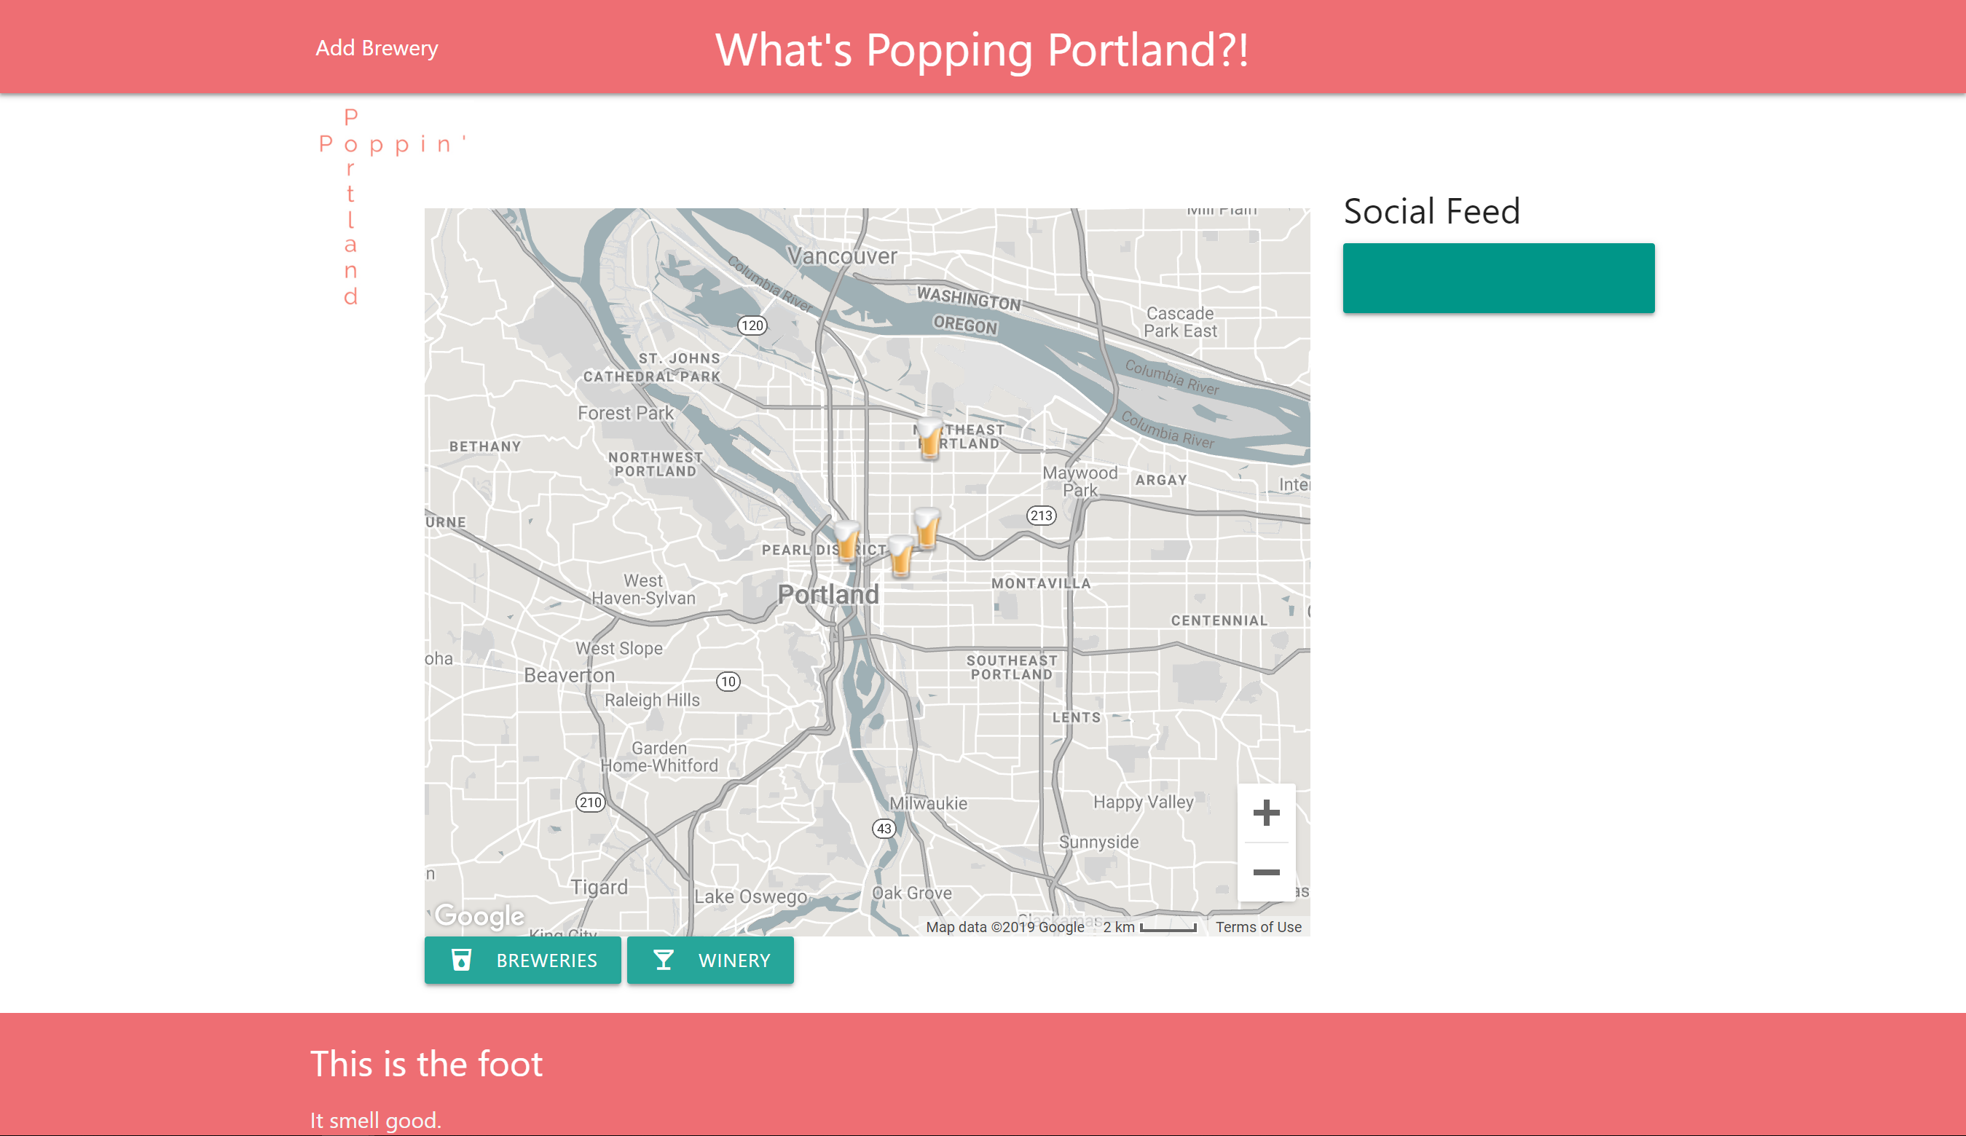
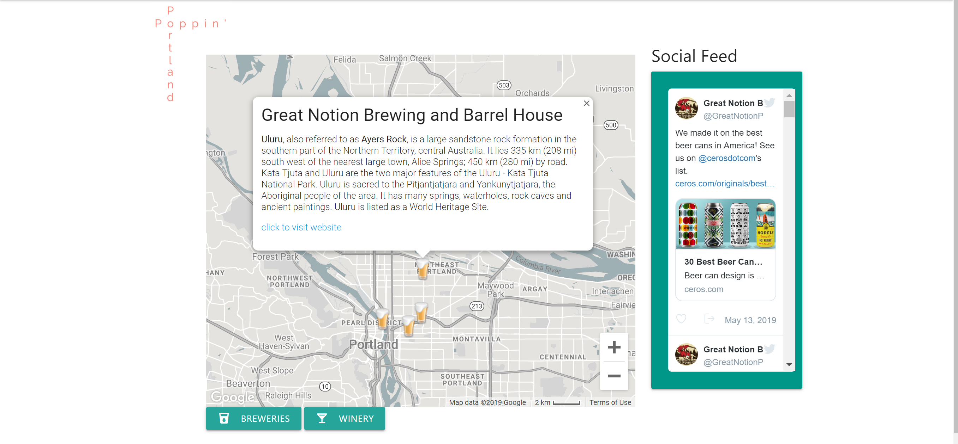

P
R
T
L
A
N
D
P O P P I N’
Breweries
Wineries
Dispensaries
Eateries

